Slide 1
Genetic Programming in hardware using FPGAs and Handel-C
Peter Martin
University of Essex, UK

Slide 2
Introduction
GP in hardware - why?
FPGAs and Handel-C
Design details
Experimental results
Conclusions

Slide 3
GP in hardware
Speed up the operation of GP
  Solve hard problems
  Real time data processing for fitness
  Experimental investigation
Embedded GP systems
  single chip GP
  low cost & low power
Notes:
Why implement GP in hardware?
The first reason is for speed. For most GP problems, the fitness function

Slide 4
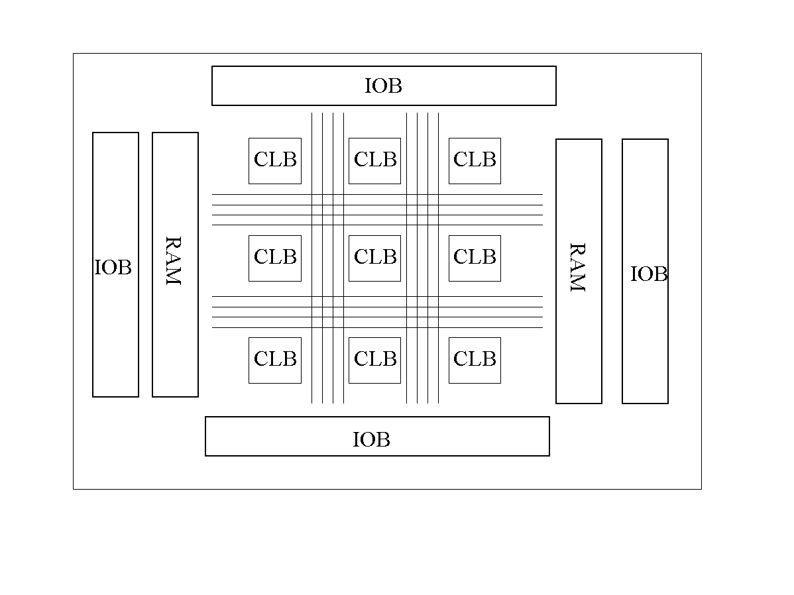
FPGAs
Re-configurable arrays of logic cells
Programmable logic functions
Flexible routing
On-chip memory

Slide 5
Handel-C
High level language to FPGA compilation
Algorithmic
C-like syntax
Extensions for parallelism
    unsigned int 5 a,b;
    par {
    a = 10;
    b = 20;
    }
Predictable timing semantics
    “Assignment takes one clock cycle, everything else is free”

Slide 6
Design
Linear representation
  No stack so recursion hard
Population in external RAM
Pipelined execution
  Combinatorial logic is slow
  Trade cycles for speed
  2 levels of pipeline
Parallel fitness evaluations
  Replicated hardware

Slide 7
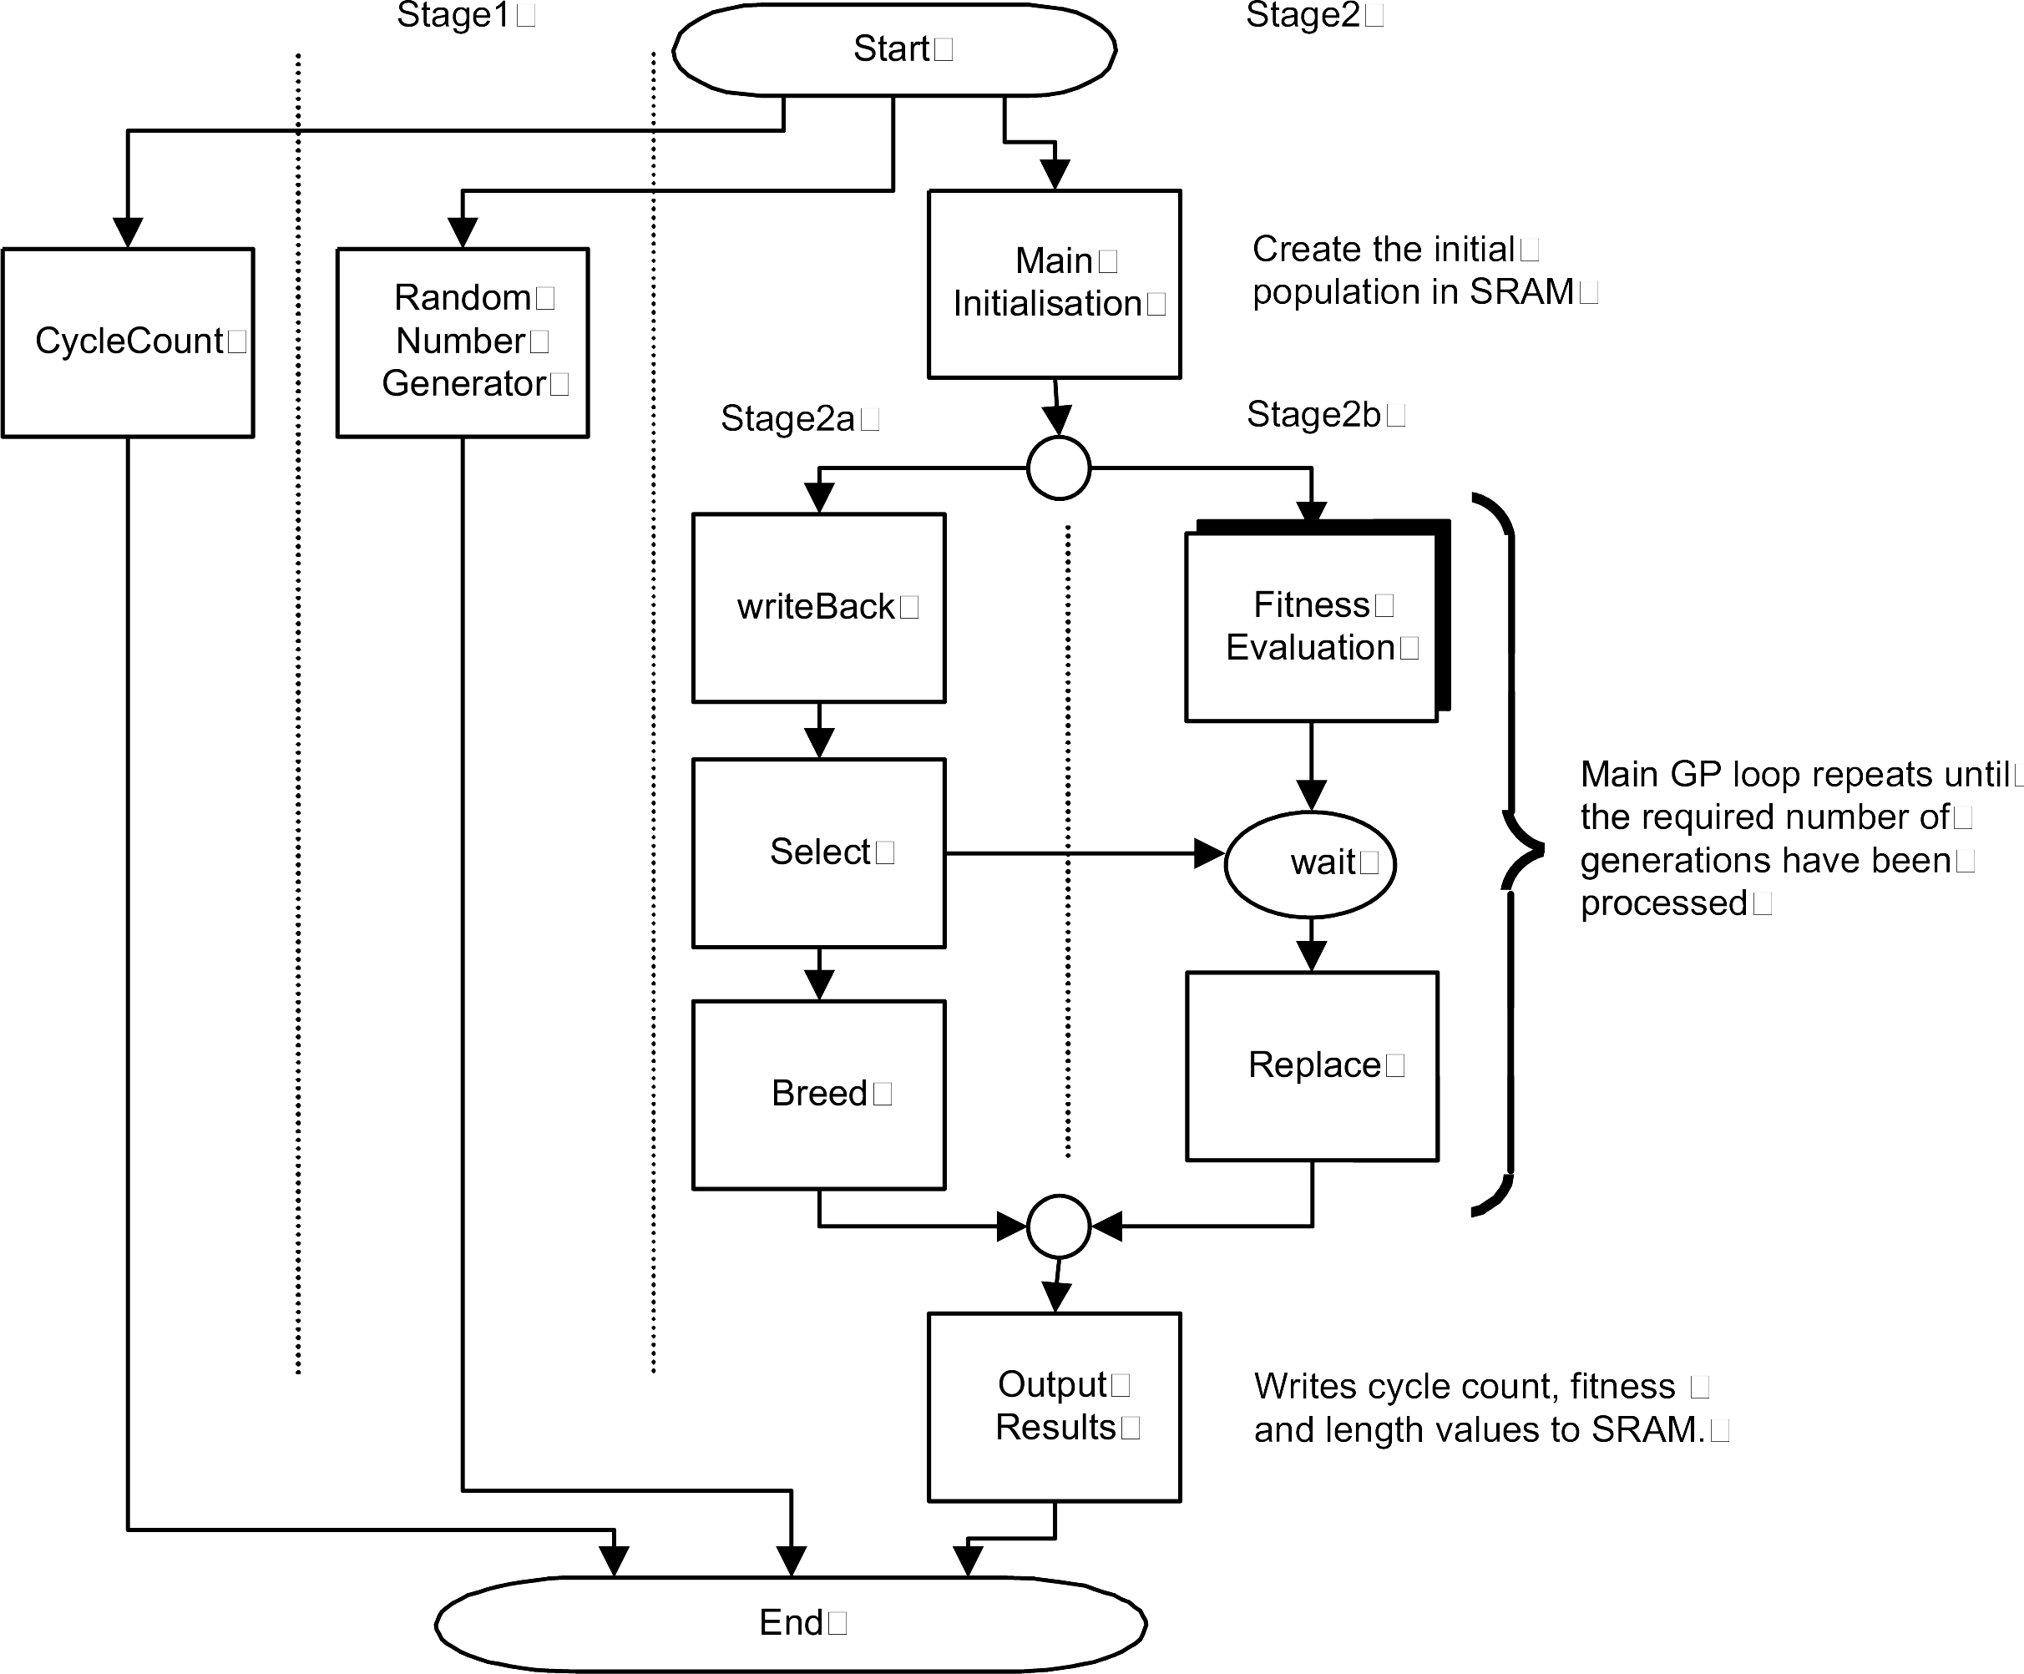

Slide 8
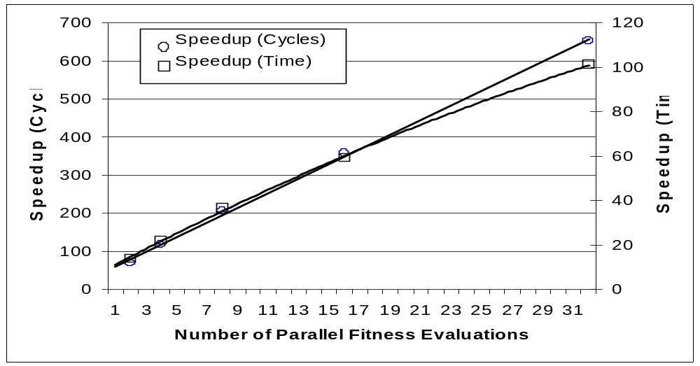
Results - Ant

Slide 9
Ant statistics
Max Frequency > 40 MHz
75% slices used
Compile time 1 hour
Place & Route 2 hours

Slide 10
Summary 1
Handel-C
  algorithmic design
  algorithm development
  code portability and reuse
  meaningful performance comparison
FPGAs
  reconfigurable (unlike ASICs)

Slide 11
Summary 2
Two orders of magnitude speed up
Time needed for development
  Hard coded function set & fitness function
Cost of hardware
Future work:
  Crossover operator behaviour
  Random number generator
  Reconfigurability
  Larger FPGAs

